Slide 1


System.out.println("Welcome to CSSE 220!");
Sit next to someone
Open the syllabus PDF (linked from Moodle) and read pages 1-3 if you haven’t already
Open the ClassMaterials/Act01 folder in the csse220 git repository that you should have cloned (i.e., copied) locally

Slide 2
Quick Moodle tour
Colorful calendar (Airtable) with start/end dates
Links to get help and ask for an extension
Syllabus

Slide 3
Goals for this course
Move from Python to Java
Lots of little programs in the first few weeks
Move from writing functions to writing whole classes from scratch
Learn how to design programs
Break up larger programs into multiple classes
Final project
Learn algorithms and data storage
Maps, sorting, mixed patterns, and problem solving

Slide 4
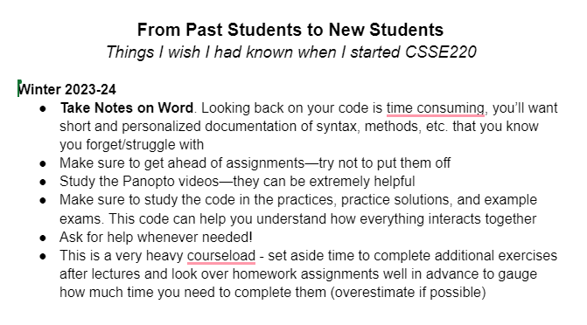
Advice from Former Students
https://docs.google.com/document/d/1gWrR8fe7Qs5B9MgRkFW4wBa-tnRdFXGTDRnqi2ps1i4/edit

Slide 5
A note on our backgrounds
RESPECT
Some have taken CSSE 120, some have not
Some have written Java code before, some have not
Some have been Rose-Hulman students for years, some for a day
But everyone is prepared to succeed in this course, and I expect:
JOYFUL EXPLORATION
ENGAGEMENT
Notes:
Everyone here comes from a different background with different experiences, both with respected to programming and just life in general.
Respect each other’s identities. Critique ideas, not people.
Focus on class material (no phones, except when prompted for recall activity). You’re adults, can determine when to step out for emergency phone call. When working on laptop/tablet, use do not disturb mode and stay on task.
Joyful exploration: Strive for “intelligent failures”: make mistakes quickly, and learn from each mistake. I’ll point out examples of what I mean when we get to certain topics.

Slide 6

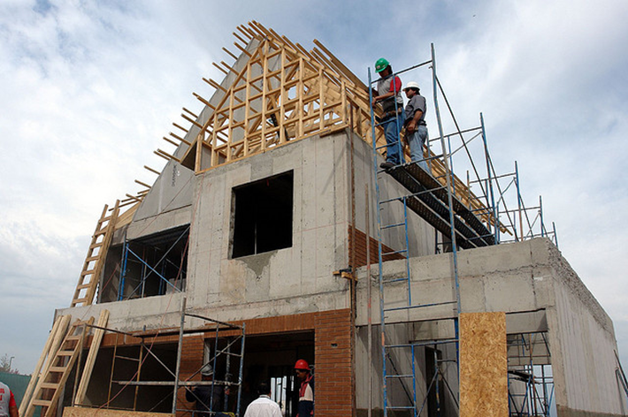
How we visualize learning has changed over time
Notes:
Distinguish passive and active learning. Briefly motivate all the active learning activities we will use in class.

Slide 7
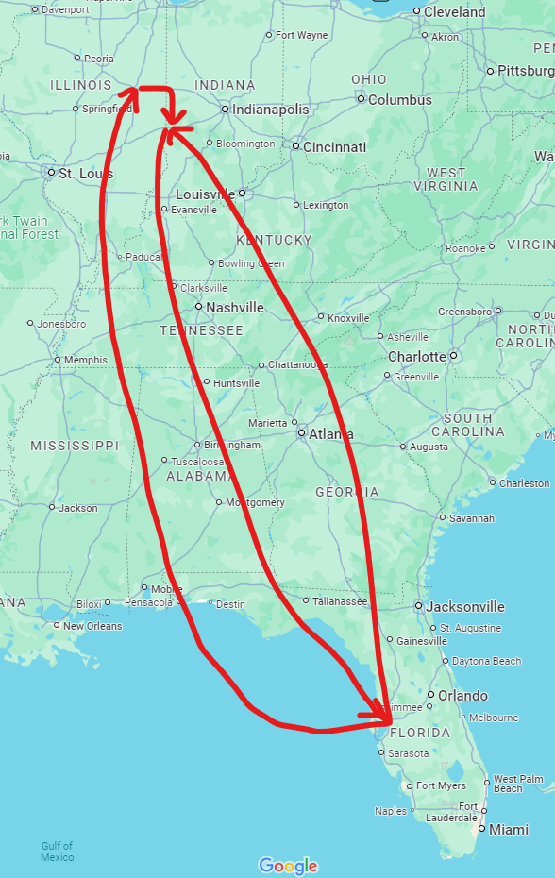
Instructor Info
Ian Ludden
Feel free to call me:
Ian, Professor/Dr. Ludden, or Professor/Dr. Ian
Originally from Tampa, Florida (grateful the Midwest has seasons)
B.S. in CPE/MA from Rose-Hulman, Fall 2016
Ph.D. in CS from UIUC in 2023
Industry experience: FitzMark (Indy), Garmin (KC), LGS (Tampa), PilotFish (Tampa)
Wrote lots of Java code at PilotFish!

Slide 8
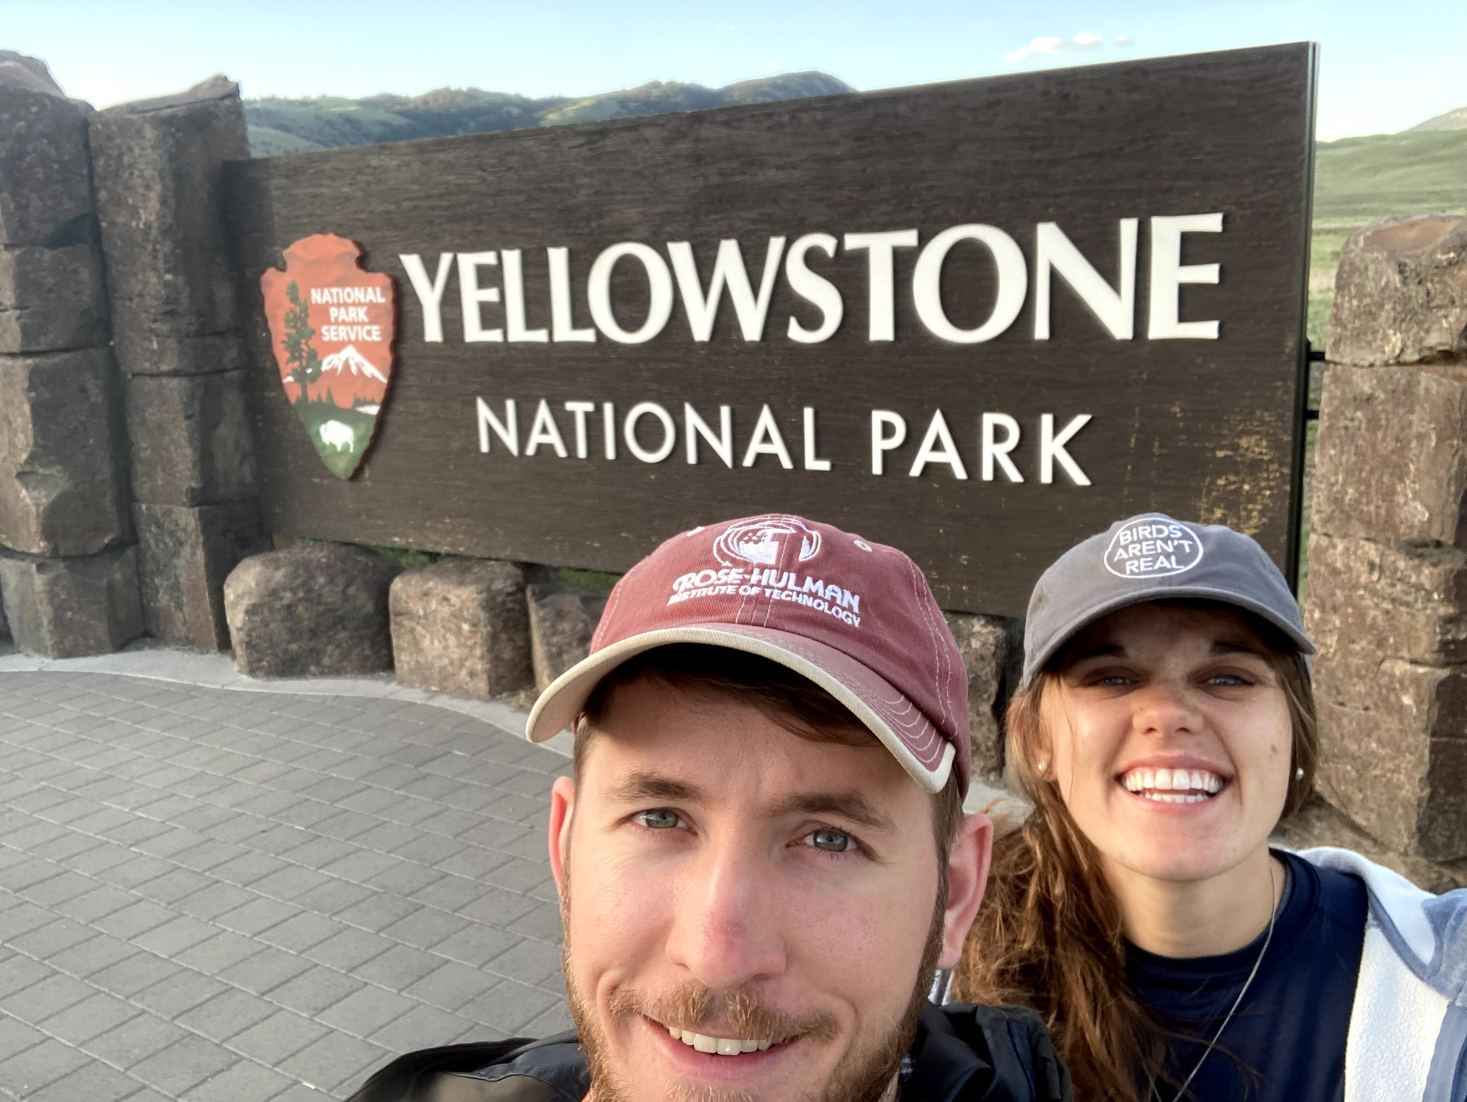
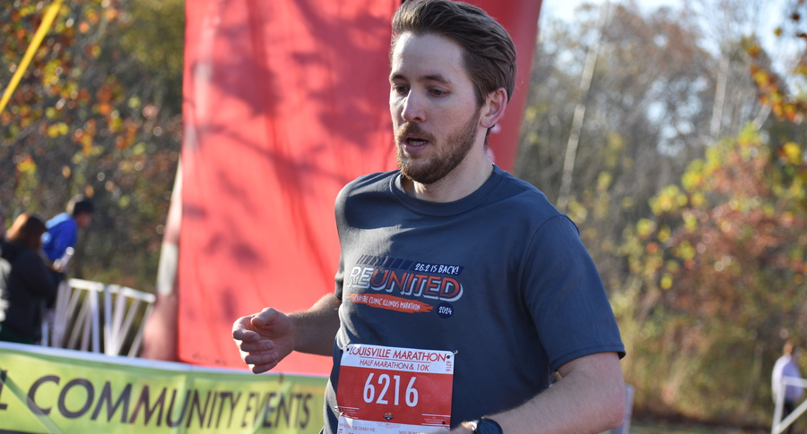


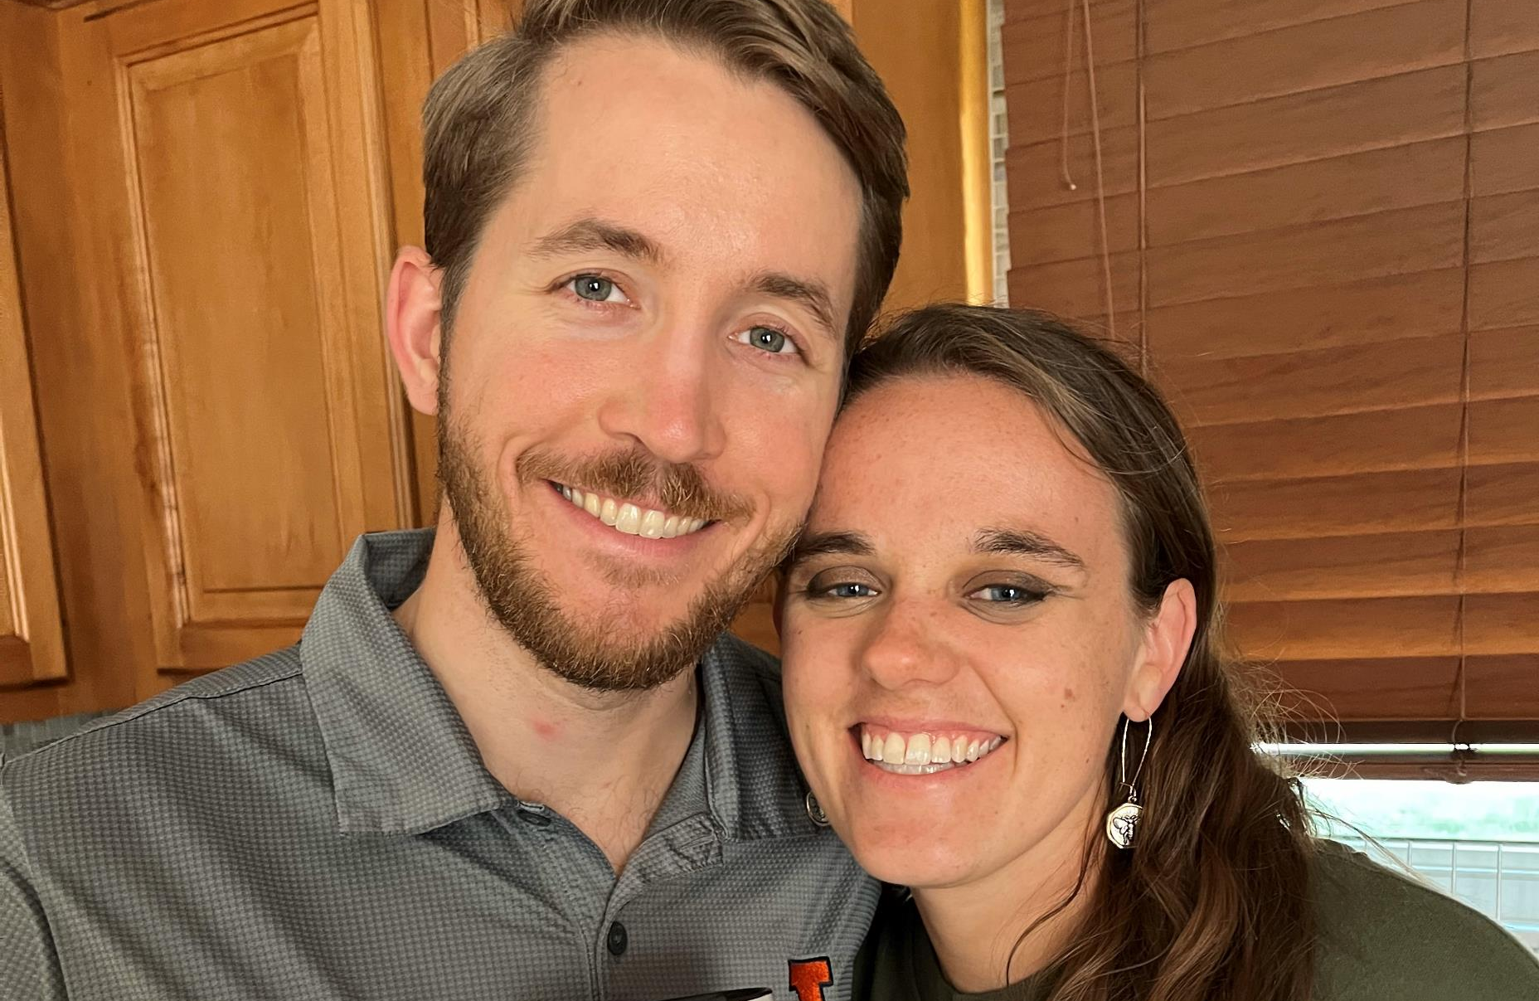


Slide 9
Instructor Info
More about me
When I was a student here:
Cross Country, Engineers Without Borders, symphony orchestra, musicals, improv club, St. Joseph’s University Ministry
Friends & activities helped me make it through Rose
Find your people!
Interested in working with students on research
Feel free to schedule appt. or email if you have interest in research
Graph theory, algorithmic game theory, operations research
Most projects require CSSE 230, but we can talk before then

Slide 10
Introductions
TA
Students (briefly! ☺ it’s a big class)
What should we call you?
What you do for fun/rejuvenation?

Slide 11
How to get help
General questions (HW, course logistics):
Please use course Teams channel
TAs or other students may be able to respond faster
Personal questions:
Office “drop-in” hours (no appointment needed)
Email
1-1 meeting, scheduled via link in email signature
Helps me plan my time effectively
Email me if you can’t find a time
Visit the Learning Center and/or Sophomore Resident Tutors (intro videos) for free peer tutoring

Slide 12
Can we just Java already?
Find a partner with a similar level of Java experience
Open the Act01 folder in file explorer and IntelliJ
Pick up an “Introduction to Java” handout

Slide 13
Act01: Introduction to Java
Work through the handout, asking questions as needed
Pause after Model 3 and check in with me

Slide 14
LLMs/genAI in CSSE 220
https://ianludden.com/csse220-genai-guide/
Foundational skills and understanding when LLMs can/can’t help
Healthy skepticism
If the design is bad, it doesn’t matter how quickly genAI can fill in the code!
There is nothing so useless as doing efficiently that which should not be done at all.
Peter Drucker

Slide 15
How not to use LLMs
“Cognitive offload”: delegating your thinking/learning
Finishing homework assignments when you run out of time
Just ask for an extension, and prioritize your learning
Solving timed assessment problems
I can’t give feedback on your learning progress if an LLM did the work

Slide 16
HW0 – How to submit
Click HW0 link in Moodle to go to Gradescope
Drag and drop HW0.java to submit
Wait for the autograder to finish running

